Slide 1
Logical Agents
Notes:
Today we will cover:
Knowledge bases
Principles of logic
Propositional logic
Inference algortihms

Slide 2
Knowledge-based Agents
Knowledge-based agents use a process of reasoning over an internal representation of knowledge to decide what action to take.
So far, our problem-solving agents have performed a search over states in order to find a plan. The representation of states has been atomic.
Limited to commands like “Navigate to Kessel”
“Take me to the nearest habitable planet”
“Take me to the nearest habitable planet where I can store my perishable cargo”

Slide 3
Logical representations
Logic can serve as a general class of representations.
Today we will cover:
Knowledge bases
Principles of logic
Propositional logic
Inference algortihms

Slide 4
Knowledge-based Agents
A central component of a knowledge-based agent is a knowledge base or KB.
A KB contains a set of sentence that are written in a knowledge representation language. The sentence contains some assertion about the world.
Natural language sentences | Knowledge representation language sentence
Hoth is a planet | planet(hoth)
Hoth is habitable | habitable(hoth)
Hoth is far from its sun | far_from(hoth, sol)
If a planet is far from its sun then it is cold | planet(x) and sun(y) and far_from(x,y) →cold(x)

Slide 5
Knowledge-based Agents
There are two kinds of sentences:
Axioms – a sentence that is given
Derived sentences – a new sentence that is derived from others sentences
The process of deriving new sentences from old sentences is called inference.
A KB can initially contain some background information about the world, and a knowledge-based agent can add to the information in the KB through its observations of the world.
In addition to asserting new knowledge into its KB, a knowledge-based agent can also query the KB and ask it to derive new knowledge in order to select what action it should take.

Slide 6
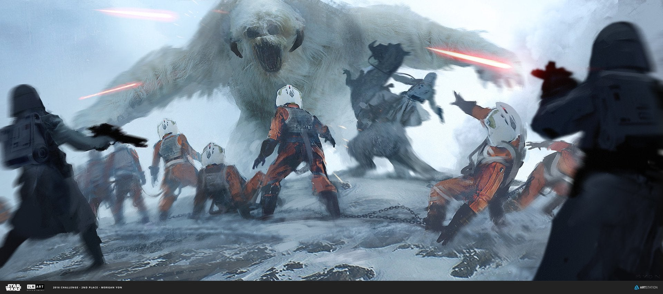
Hunt the Wampas
Notes:
In this section we’ll describe an environment that demonstrates why knowledge-based agents are good.
The agent explores a cave consisting of rooms connected by passageways.
Lurking somewhere in the cave is the Wumpus, a beast that eats any agent that enters its room.
Some rooms contain bottomless pits that trap any agent that wanders into the room.
In one room is master Luke.
The goal is:
to collect luke and
exit the world
without being eaten

Slide 7

Wampa World
Our knowledge-based agent, R2D2, explores a cave consisting of rooms connected by passageways.
Lurking somewhere in the cave is the Wampa, a beast that eats any agent that enters its room.
Some rooms contain bottomless pits that trap any agent that wanders into the room.
In one room is master Luke.
The goal is:
collect Luke
exit the world
without being eaten
Notes:
Lurking somewhere in the cave is the Wumpus, a beast that eats any agent that enters its room.
Some rooms contain bottomless pits that trap any agent that wanders into the room.
In one room is master Luke.
The goal is:
to collect luke and
exit the world
without being eaten

Slide 8
Wampa World
PIT
4
Environment: A 4x4 grid of rooms. The agent starts in the square [1,1]. Wampa and Luke are randomly placed in other squares. Each square can be pit with 20% probability.
PIT
3
2
PIT
1
1
2
3
4
Notes:
http://www.bluemilkspecial.com/comic/wampa-cave-3/

Slide 9
Wampa World
PIT
4
Performance measure:
+1000 points for rescuing Luke and leaving the cave
-1000 for falling into a pit or being eaten by the Wampa -1 for each action taken -10 for using up your blaster fire
PIT
3
2
PIT
1
1
2
3
4
Notes:
http://www.bluemilkspecial.com/comic/wampa-cave-3/

Slide 10
Wampa World
PIT
4
Actuators:
R2 can move Forward, TurnLeft, Turn right.
Agent dies if it moves into a pit or a Wumpus square.
Grab can pick up Luke.
Shoot fires blaster bolt in a straight line in the direction that R2D2 is facing.
If the blaster hits the Wampa, it dies. R2 only has enough power for one shot.
Climb gets R2 out of the cave but only works in [1, 1]
PIT
3
2
PIT
1
1
2
3
4
Notes:
http://www.bluemilkspecial.com/comic/wampa-cave-3/

Slide 11
Wampa World
Stench
Breeze
PIT
4
Sensors:
In each square adjacent to the Wampa, R2D2’s olfactory sensor perceives a Stench
In each square adjacent to a pit, R2D2’s wind sensor perceives a Breeze
In the square with Luke, R2D2’s audio sensor perceives a Gasp
When R2D2 walks into a wall it perceives a Bump
When the Wampa is killed , R2D2’s audio sensor perceives a Scream
Percept=[Stench, Breeze, None, None, None]
Breeze
Breeze
PIT
3
Stench
Stench
Breeze
2
Breeze
PIT
Breeze
1
1
2
3
4
Notes:
http://www.bluemilkspecial.com/comic/wampa-cave-3/

Slide 12
Wampa World
Stench
Breeze
PIT
4
Deterministic, discrete, static, single-agent (Wampa doesn’t move)
Sequential because reward doesn’t come for many steps
Partially observable because some parts of the state are not directly perceivable:
- Location of Luke, Wampa, and pits aren’t directly observable.
Breeze
Breeze
PIT
3
Stench
Breeze
2
Breeze
PIT
Breeze
1
1
2
3
4
Notes:
http://www.bluemilkspecial.com/comic/wampa-cave-3/

Slide 13
Wampa World Walkthrough
PIT
4
R2D2 starts in [1,1]
Percept=[None, None, None, None, None]
What can we conclude about [1,2] and [2,1]?
PIT
3
OK
2
OK
OK
PIT
1
1
2
3
4
Notes:
http://www.bluemilkspecial.com/comic/wampa-cave-3/

Slide 14
Wampa World Walkthrough
PIT
4
R2D2 moves to [1,2]
Percept=[Stench, None, None, None None]
What can we conclude about [3,1]?
PIT
3
Stench
OK
2
OK
OK
PIT
1
1
2
3
4
Notes:
http://www.bluemilkspecial.com/comic/wampa-cave-3/

Slide 15
Wampa World Walkthrough
PIT
4
R2D2 moves to [2,1]
Percept=[None, Breeze, None, None None]
What can we conclude about [3,1]?
What can we conclude about [2,2]?
PIT
3
Stench
OK
OK
2
Visited
OK
Breeze
OK
PIT
1
Visited
1
2
3
4
Notes:
http://www.bluemilkspecial.com/comic/wampa-cave-3/

Slide 16
Wampa World Walkthrough
PIT
4
R2D2 moves to [2,2]
Percept=[None, None, None, None None]
What can we conclude about [3,2] and [2,3]?
OK
PIT
3
Stench
OK
OK
OK
2
Visited
OK
Breeze
OK
PIT
1
Visited
Visited
1
2
3
4
Notes:
http://www.bluemilkspecial.com/comic/wampa-cave-3/

Slide 17
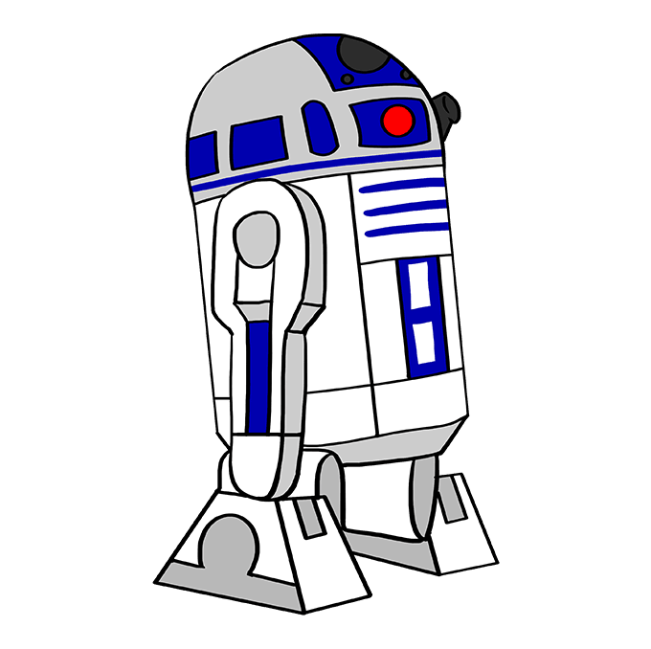
Wampa World Walkthrough
PIT
4
Pit?
R2D2 moves to [2,2]
Percept=[Stench, Breeze, Gasp, None None]
Who is here?
What is in [2,4] and [3,3]?
Stench
OK
PIT
3
Breeze
Pit?
Stench
OK
OK
OK
2
Visited
Visited
OK
OK
PIT
1
Visited
Visited
1
2
3
4
Notes:
http://www.bluemilkspecial.com/comic/wampa-cave-3/

Slide 18
Logic
Logic can serve as a general class of representations for knowledge-based agents. Here we are going to examine Propositional Logic.
KB consists of sentences in the representation language
Representation language has a syntax that specifies sentences that are well-formed
A logic defines the semantics of the sentences, which is their meaning
The semantics defines the truth of each sentence with respect to a possible world, which we will often call a model.

Slide 19
Possible worlds and models
Models are mathematical abstractions that have a fixed set of truth values which are {true, false} for each sentence.
If sentence 𝛂 is true in model m then we say
m satisfies 𝛂, or
m is a model of 𝛂
We use the notation M(𝛂) to mean the set of all models of 𝛂.
For instance, 𝛂 could be a sentence that means “there is no pit in [2,2]”. In that case, M(𝛂) would be all instances of Wampa World where [2,2] doesn’t have a pit.

Slide 20
Logical Entailment
Once we have a notion of truth, we can start to define logical reasoning. Logical reasoning involves the entailment relation between sentence.
In plain English, entailment is the idea that a sentence follows logically from another sentence.
To write sentence 𝛂 entails sentence β in mathematical notation we use the ⊨ symbol:
𝛂⊨β
The definition is
𝛂⊨β if and only if M(𝛂) ⊆ M(β)
This means that 𝛂 is more specific, or stronger than, β. For instances, β could mean that “The agent is a robot” and 𝛂 could mean “The agent is an astromech”.

Slide 21
Knowledge Base
PIT
4
Pit?
The KB can be thought of as a set of sentences.
𝛂₁ = “There is no pit in [1,2]”
𝛂₂ = “There is a pit in [3,1]”
𝛂₃ = “There is a wampa in [1,3]”
The KB is false in models that contradict what the agent knows. For example, the KB is false in any model m where [1,2] contains a pit.
Model checking is the process of enumerating all possible models that are compatible with the KB. M(KB) ⊆ M(𝛂₁ )
Stench
OK
PIT
3
Breeze
Pit?
Stench
OK
OK
OK
2
Visited
Visited
OK
OK
PIT
1
Visited
Visited
1
2
3
4
Notes:
http://www.bluemilkspecial.com/comic/wampa-cave-3/

Slide 22
Logical inference
Entailment can be applied to derive conclusions, which is the process of logical inference.
We can think about the consequences of a KB as a large set of additional sentences that are entailed given the sentences that have been added to the KB.
We would like to design inference algorithms to enumerate these sentences.
When an inference algorithm i allows us to conclude that 𝛂 is true, then we write
KB ⊢_{i} 𝛂
“𝛂 is derived from KB by i”

Slide 23
Propositional Logic
Atomic sentences are represented with a single propositional symbols.
Propositional symbols stand for a statement that can be true or false.
For example, W_{1,3} is a propositional symbol that we choose to stand for
“There is a Wampa at location [1,3]”
That statement can be true or false.
The symbol FacingEast could stand for “The agent is currently facing East”.

Slide 24
Propositional Logic
Complex sentences are constructed from simpler ones using parentheses and logical connectives.
Logical Connective | Meaning
¬ (not) | ¬W_{1,3} is the negation of W_{1,3}
⋀ (and) | W_{1,3} ⋀ P_{3,1} is called a conjunction
⋁ (or) | W_{1,3} ⋁ P_{3,1} is called a disjunction
⟹ (implies) | W_{1,3} ⟹ S_{1,2} is called an implication. W_{1,3} is its premise or antecede and S_{1,2} is its conclusion or consequence
⇔ (if and only if) | W_{1,3}⇔¬W_{3,4} is called an biconditional

Slide 25
Truth Tables

Slide 26
Truth Tables

Slide 27
Truth Tables

Slide 28
Truth Tables

Slide 29
Truth Tables
Which of these scenarios did I lie in, or break my promise to you?
Notes:
Now, in which of these four scenarios did I tell a lie, or break my promise to you? It seems that I ONLY told a lie in the scenario where you DID come over to help me, but I did NOT buy you pizza. So, “P  Q” is only false when “P” is true and “Q” is false.

Slide 30
Truth Tables
Shorthand for P⟹Q ⋀ Q⟹P
Which of these scenarios did I lie in?
Notes:
If I say that “Peggy will go if and ONLY if Quinn goes”, I have told a lie in scenarios 2 and 3, but I have NOT lied in scenarios 1 and 4.

Slide 31
A Simple Knowledge Base
Now that we’ve defined the semantics of propositional logic, we can construct a knowledge base for Wampa World. Let’s start with a set of symbols for each location [x,y]:
P_{x,y} is true if there is a pit in [x,y]
W_{x,y} is true if there is a Wampa in [x,y], alive or dead
B_{x,y} is true if there is a breeze in [x,y]
S_{x,y} is true if there is a stench in [x,y]
L_{x,y} is true if R2D2 is in location [x,y]

Slide 32
A Simple Knowledge Base
Logical Connective
¬ (not)
⋀ (and)
⋁ (or)
⟹ (implies)
⇔ (if and only if)
We can construct sentences out of these using our logical connectors. We’ll label each sentence.
R1: ¬ P_{1,1}
R2: B_{1,1} ⇔ (P_{1,2} ⋁ P_{2,1} )
R3: B_{2,1} ⇔ (P_{1,1} ⋁ P_{2,2} ⋁ P_{3,1} )
These are true of all Wampa Worlds.
4
3
2
1
1
2
3
4

Slide 33
A Simple Knowledge Base
Logical Connective
¬ (not)
⋀ (and)
⋁ (or)
⟹ (implies)
⇔ (if and only if)
We can construct sentences out of these using our logical connectors. We’ll label each sentence.
R1: ¬ P_{1,1}
R2: B_{1,1} ⇔ (P_{1,2} ⋁ P_{2,1} )
R3: B_{2,1} ⇔ (P_{1,1} ⋁ P_{2,2} ⋁ P_{3,1} )
What if we perceive the presence or absence of breeze in [1,1], [2,1]?
R4: ¬ B_{1,1}
R5: B_{2,1}
4
3
2
1
No Breeze
Breeze
1
2
3
4

Slide 34
A Simple Knowledge Base
Logical Connective
¬ (not)
⋀ (and)
⋁ (or)
⟹ (implies)
⇔ (if and only if)
We can construct sentences out of these using our logical connectors. We’ll label each sentence.
R1: ¬ P_{1,1}
R2: B_{1,1} ⇔ (P_{1,2} ⋁ P_{2,1} )
R3: B_{2,1} ⇔ (P_{1,1} ⋁ P_{2,2} ⋁ P_{3,1} )
R4: ¬ B_{1,1}
R5: B_{2,1}
Can mechanically combine the sentences in our KB to prove that a pit exists at any location?
4
3
2
Pit?
Pit?
Pit?
1
No Breeze
Breeze
Pit?
1
2
3
4

Slide 35
Inference and Proofs
Logical Connective
¬ (not)
⋀ (and)
⋁ (or)
⟹ (implies)
⇔ (if and only if)
Inference Rules can be used to derive proofs.
The best-known inference rule is Modus Ponens
𝛂⟹β, 𝛂
β
𝛂⋀β
𝛂
𝛂 ⇔ β
(𝛂 ⟹ β) ⋀ (β ⟹ 𝛂)

Slide 36
Inference and Proofs
Logical Connective
¬ (not)
⋀ (and)
⋁ (or)
⟹ (implies)
⇔ (if and only if)
Inference Rules can be used to derive proofs.
The best-known inference rule is Modus Ponens
𝛂⟹β, 𝛂
β
𝛂⋀β
𝛂
𝛂 ⇔ β
(𝛂 ⟹ β) ⋀ (β ⟹ 𝛂)

